Slide 1
Inferring population size changes over time. Clustering of populations using haplotype-based and tree-based methods. Inference of coalescence rates and effective population sizes
Oscar Lao

Slide 2
Overview
Why infer population history?
Three main goals:
1. Reconstruct past population size changes
2. Identify population structure via clustering
3. Infer coalescence rates and effective population size (Ne)

Slide 3
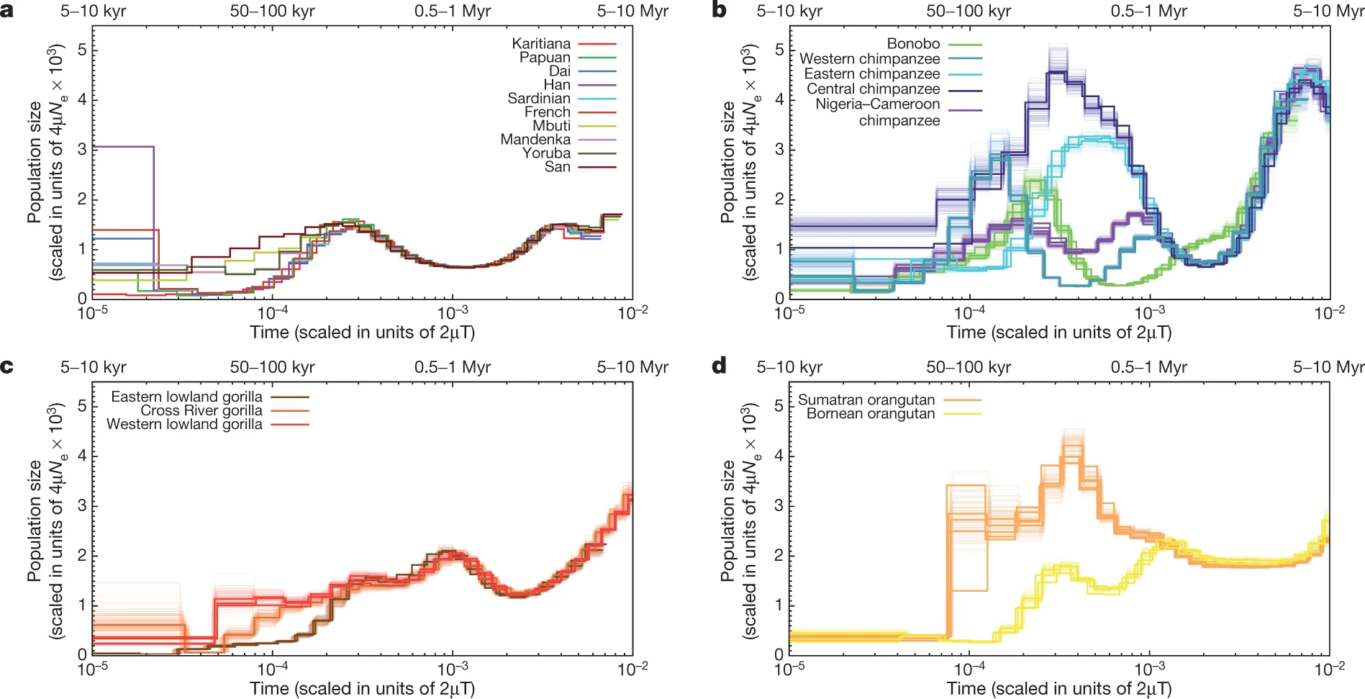

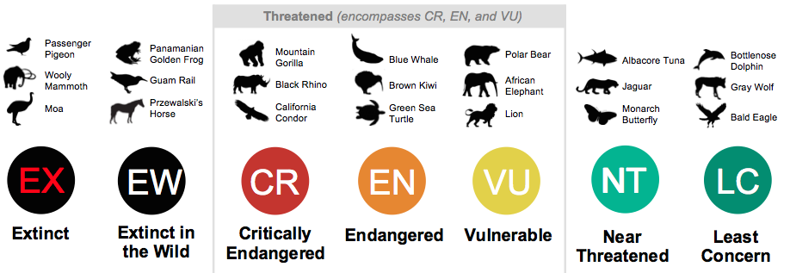
Conservation genetics and estimation of effective population size over time
Adapted from Alba Nieto

Slide 4
Interpreting Effective Population Size (Ne)
Ne ≠ census size — measures genetic drift
Sensitive to bottlenecks, admixture, selection
Ne provides insight into the evolutionary past

Slide 5
REMEMBER: ALL YOU NEED IS COALESCENCE
Ne

Slide 6
REMEMBER: ALL YOU NEED IS COALESCENCE
Ancestor of all the chromosomes of present
Time of the Most Recent Common Ancestor (TMRCA)

Slide 7
GOING BEYOND WRIGHT-FISHER BOTLENECKS
Higher probability of introducing rare mutations
Almost all coalescences occur in a very small amount of time
Sudden population reduction
Sudden population expansion
Notes:
Knock-out mice and inbreeding

Slide 8
GOING BEYOND WRIGHT-FISHER BOTLENECKS
TMRCA falls more likely within the bottleneck as the bottleneck becomes stronger (characterized by smaller effective population size, Ne, and longer duration).
Notes:
Knock-out mice and inbreeding

Slide 9
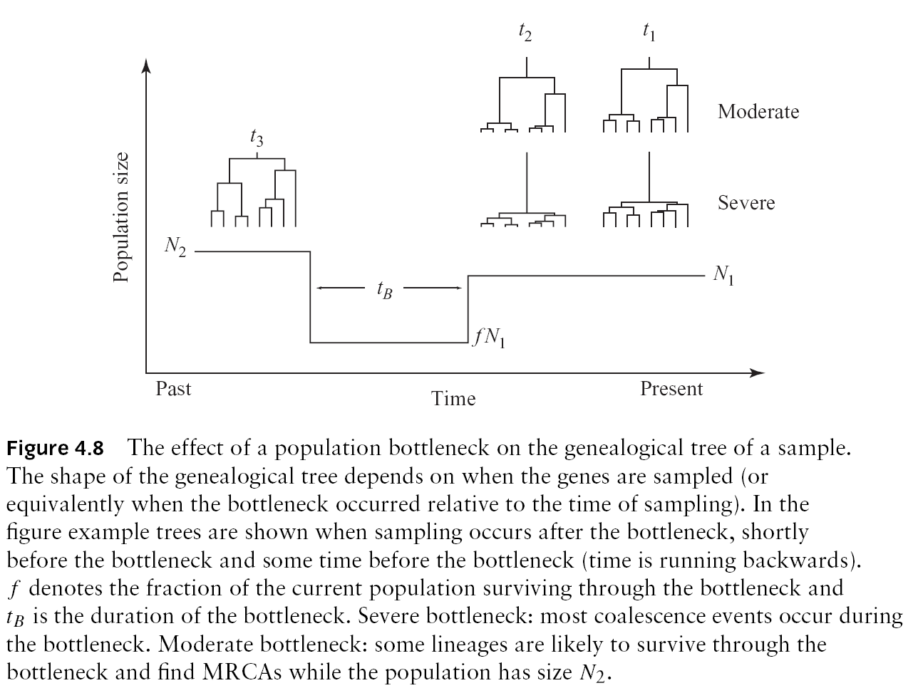
GOING BEYOND WRIGHT-FISHER BOTLENECKS

Slide 10
GOING BEYOND WRIGHT-FISHER POPULATION SUBSTRUCTURE

Slide 11
GOING BEYOND WRIGHT-FISHER POPULATION SUBSTRUCTURE AND COALESCENCE
Deme1
Ne
Barrier
Deme2
Demes evolve independently
Time of split

Slide 12
GOING BEYOND WRIGHT-FISHER POPULATION SUBSTRUCTURE AND COALESCENCE
TMRCA falls BEFORE the split between populations
Deme1
Ne
Deme2
Share the same genetic diversity within demes

Slide 13
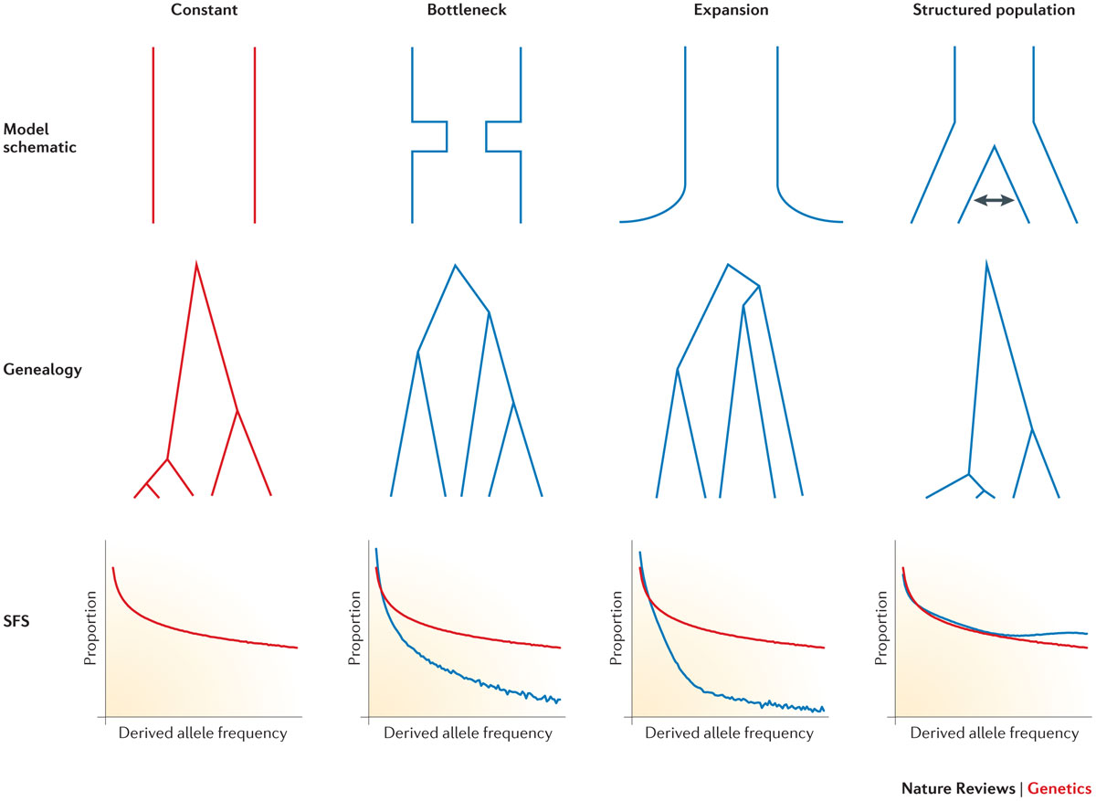
GOING BEYOND WRIGHT-FISHER POPULATION SUBSTRUCTURE AND COALESCENCE
Nature Reviews Genetics volume 16, 727–740 (2015)

Slide 14
GOING BEYOND WRIGHT-FISHER SELECTION AND COALESCENCE
Coalescences occur much faster than expected under W-F model before the mutation is fixed
The tree is not independent of the mutations. It becomes associated to the mutation under selection
After fixation, we go back to the W-F model under neutrality

Slide 15
Coalescence under strong selection
Reduced amount of diversity
Large number of private mutations
The shape of the tree is compressed
Large number of coalescence events in few generations
Notes:
Introduce example of cancer

Slide 16
Coalescence and inference
Frequency
t
t
Time TMRCA
Examples of execution of coalescence of two chromosomes under this model

Slide 17
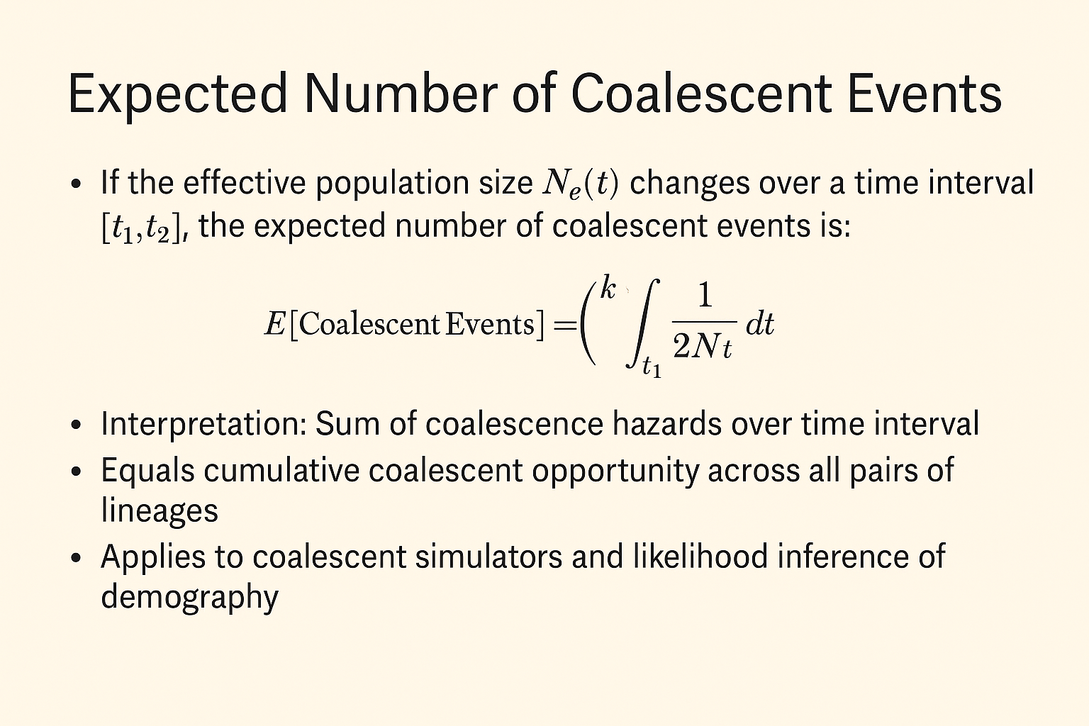
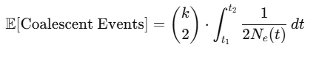
Coalescence events over time

Slide 18
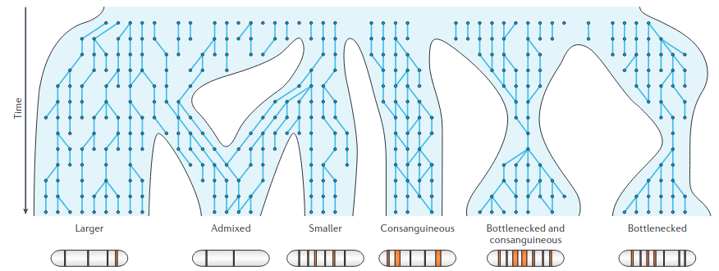
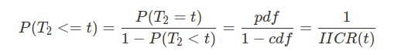
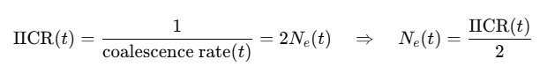
Coalescence events over time
Coalescent rate of a sample depends on all demographic and evolutionary process of its genealogy
Adapted from Alba Nieto

Slide 19
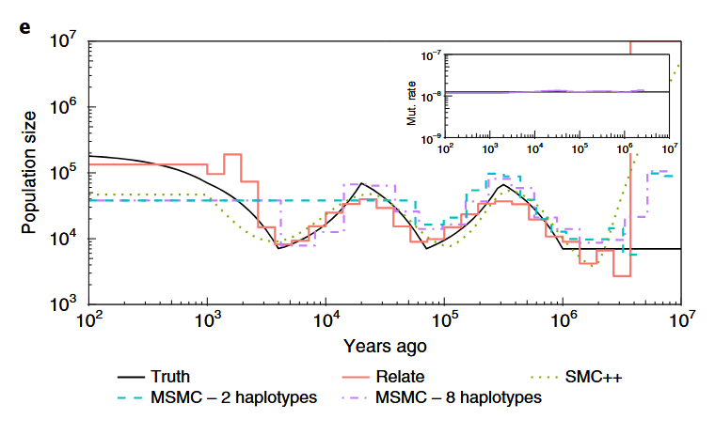
Estimating effective population size thanks to TMCRA
If we asume we have a single evolving population, then the coalescence rates are proxies for Ne

Slide 20
Diploid organisms also have RECOMBINATION
Parent 1
Parent 2
In forward
New Individual

Slide 21
Diploid organisms also have RECOMBINATION
Parent 1
Parent 2
In backward
New Individual

Slide 22
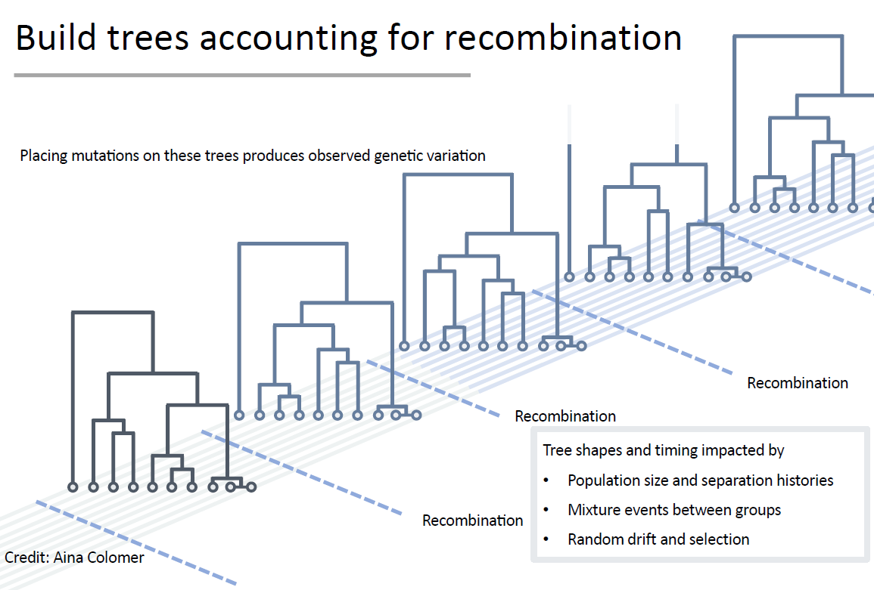
Modelling Coallescence with Recombination

Slide 23
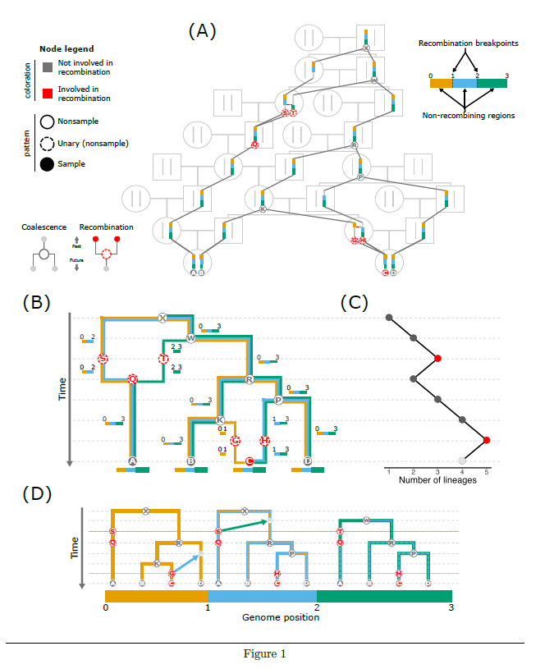
Diploid organisms also have RECOMBINATION
The era of the ARG: an empiricist’s guide to ancestral recombination graphs
ancestral recombination graphs

Slide 24
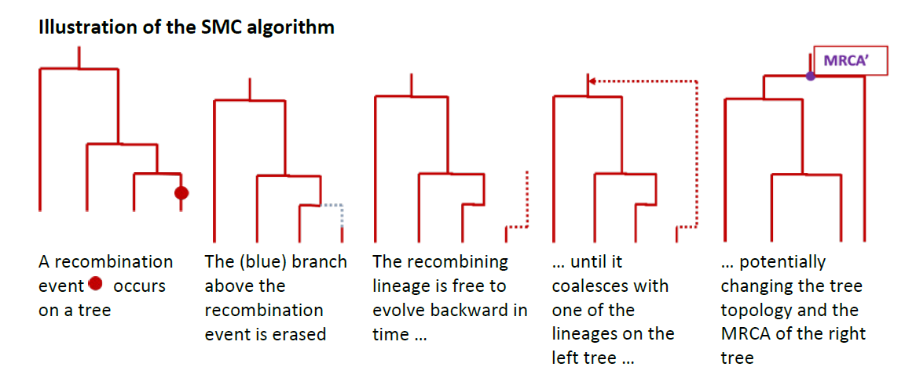
Diploid organisms also have RECOMBINATION
Secuential Markov Chain algorithm for simulating genomic regions with recombination
From fastSimcoal2 manual

Slide 25
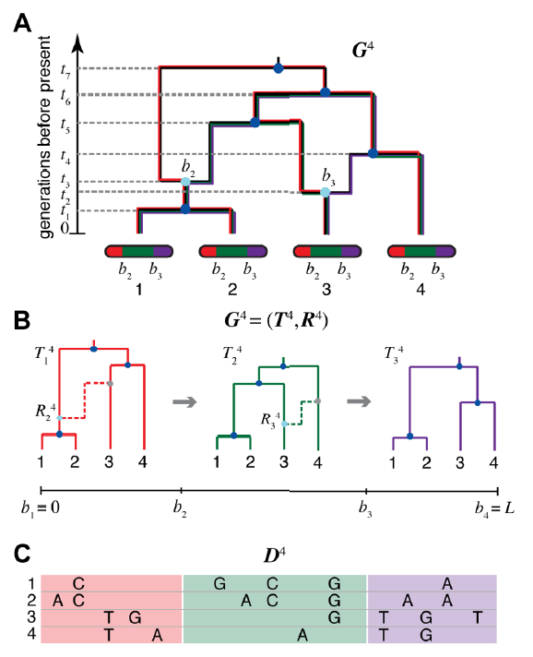
Remember: we have to infer it from the genomic data

Slide 26
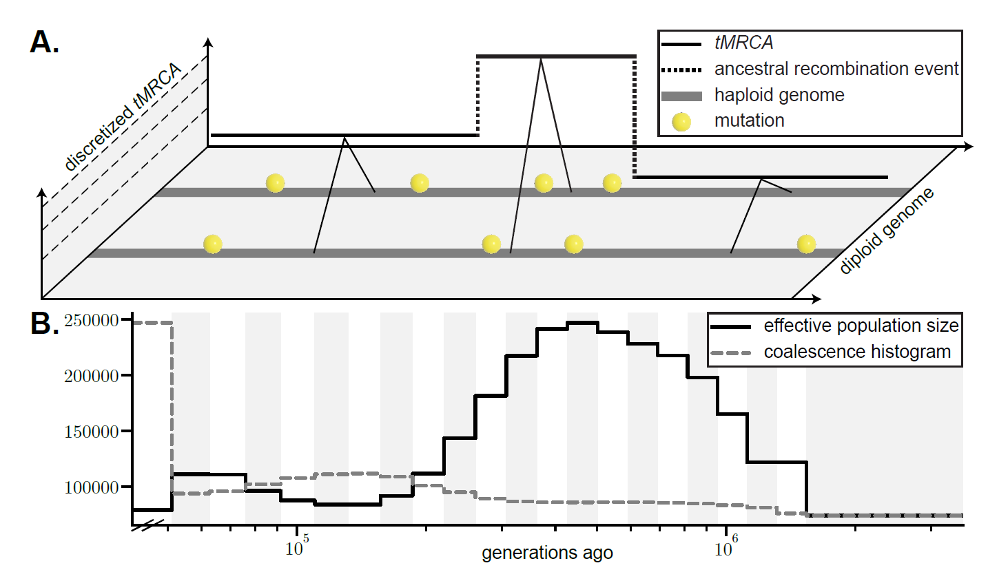
Identifying chuncks with the same tMRCA
Not Just Ne Ne-more: New Applications for SMC from Ecology to Phylogenies

Slide 27
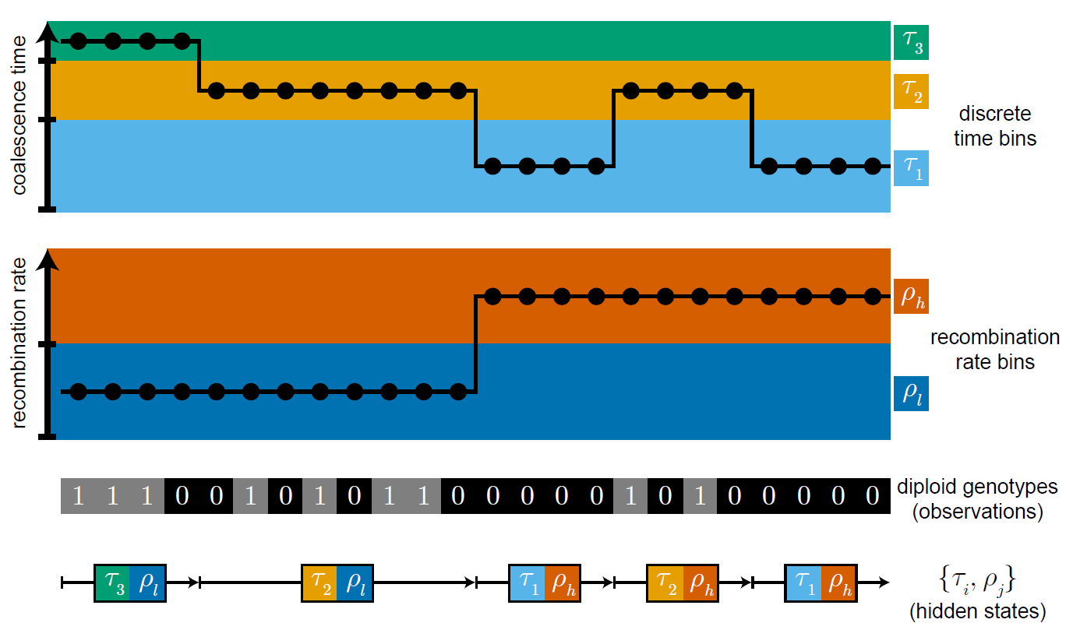
Remember: we have to infer it from the genomic data
How to estimate it?
Not Just Ne Ne-more: New Applications for SMC from Ecology to Phylogenies

Slide 28


HMM: A simple working case
The occasionally dishonest casino problem
With some probability, the casino uses a dice that is LOADED so the number six (the bench wins) occurs more often (P(6)=0.5 than expected at random.
HOW CAN WE KNOW WHEN IT IS LOADED OF FAIR?

Slide 29

HMM: A simple working case
The occasionally dishonest casino problem
0.95
State Fair
State Loaded
0.9
Probability of making a change from one state to another
0.1
0.05
Emission probabilities of fair dice
Emission probabilities of loaded dice
1 | 2 | 3 | 4 | 5 | 6
1/6 | 1/6 | 1/6 | 1/6 | 1/6 | 1/6
1 | 2 | 3 | 4 | 5 | 6
1/10 | 1/10 | 1/10 | 1/10 | 1/10 | 1/2
Fair (F) dice
Loaded (L) dice

Slide 30
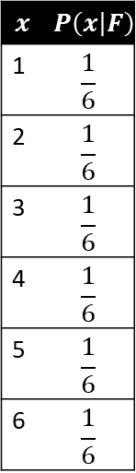
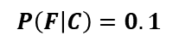
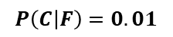
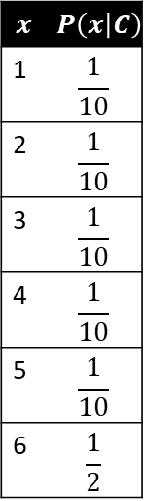
HMM: Probability of x given model?
P(1,3,4,5,1,2,6,6,3,6,6,2,1,2,4,5|HMM)
$$x$$ | $$P\left(x | F\right)$$
1 | $$\frac{1}{6}$$
2 | $$\frac{1}{6}$$
3 | $$\frac{1}{6}$$
4 | $$\frac{1}{6}$$
5 | $$\frac{1}{6}$$
6 | $$\frac{1}{6}$$
Transition probabilities
$$x$$ | $$P\left(x | C\right)$$
1 | $$\frac{1}{10}$$
2 | $$\frac{1}{10}$$
3 | $$\frac{1}{10}$$
4 | $$\frac{1}{10}$$
5 | $$\frac{1}{10}$$
6 | $$\frac{1}{2}$$
It refers to the values of emission and transmission that are used for the k considered states
$$P\left(C | F\right)=0.01$$
$$P\left(F | C\right)=0.1$$
Emission probabilities
of Fair
Emission probabilities
of Charged

Slide 31
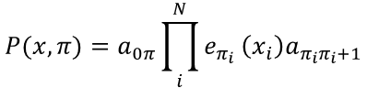
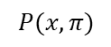
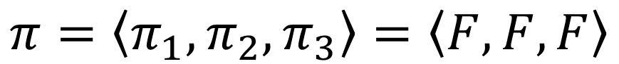
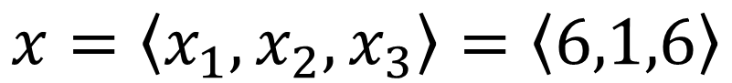
HMM: Estimating the probability of an observed sequence of events
Probability of a sequence x given that the states of the sequence are known and we have the HMM model
Imagine we observe the sequence x
$$x=\left\langle x_{1},x_{2},x_{3}\right\rangle =\left\langle 6,1,6\right\rangle$$
Assume that the prior probability of starting at one state or at the other is the same (0.5)
What would be the probability
$$P(x,π)$$
if the state sequence was
$$π=\left\langle π_{1},π_{2},π_{3}\right\rangle =\left\langle F,F,F\right\rangle$$
$$P(x,π)=a_{0π}{\prod_{i}^{N}{e_{π_{i}}}\left(x_{i}\right)a}_{π_{i}π_{i}+1}$$
$$P\left(x,π\right)=0.5∗0.95∗\frac{1}{6}∗0.95∗\frac{1}{6}∗0.95∗\frac{1}{6}=0.001984664$$
Prior of starting at F
Prob of staying at state F
Emission prob of 6 at state F

Slide 32
HMM
What happens when the parameters are not known?
?
State Fair
State Loaded
?
Probability of making a change from one state to another
?
?
Emission probabilities of fair dice
Emission probabilities of loaded dice
1 | 2 | 3 | 4 | 5 | 6
? | ? | ? | ? | ? | ?
1 | 2 | 3 | 4 | 5 | 6
? | ? | ? | ? | ? | ?
Fair (F) dice
Loaded (L) dice
P(1,3,4,5,1,2,6,6,3,6,6,2,1,2,4,5|HMM)

Slide 33
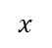
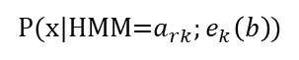
HMM
The occasionally dishonest casino problem
Unknown paths
$$x$$
1,4,5,1,3,2,1,6,6,4,1,6,6,6,6,6,2,3,4,5,1,4,3,6,2,1,3,5,6,6,6,6,6,6,6,1,2,3,1,1,1,1,2,3,4,5,5,4
P(x|HMM=$a_{rk};e_{k}\left(b\right)$)
Likelihood of an observed sequence given a set of transition and emission probabilities from a given HMM, computed using the forward algorithm
How to find HMM that maximizes P(X|HMM)?
How to know at each position of the sequence which is the most likely state (i.e. tmrca class)?

Slide 34
HMM
How to find HMM that maximizes P(X|HMM)?
Xi with maximum f(x) over all the function
Shape of the function is unknown
(we only know f(xi) when we evaluate x)
Xi with maximum f(x) over the surrounding area
There are different algorithms to infer the parameters of the HMM and the State of the elements in the sequence

Slide 35
Algorithms to Infer Ne over Time
Method | Data Input | Time Scale | Assumptions | Software/Tool
PSMC | One diploid genome | Ancient (~10 kya to 1 Mya) | Constant mutation rate, recombination map | psmc
MSMC | Multiple phased haplotypes | Mid–ancient (~2 kya to 1 Mya) | Coalescent with recombination | msmc, msmc2
SMC++ | Many unphased genomes + SFS | Recent to ancient | Combines SFS and HMM; scalable | smc++
Stairway Plot | Site Frequency Spectrum (SFS) | Broad (user-defined bins) | Neutral model, correct SFS | stairway_plot
Relate | Large number of phased genomes | Fine-grained, genome-wide | Ancestral recombination graph; mutation rate known | relate
GONE | Linkage disequilibrium (LD) from genotypes | Recent (0–100 generations) | Random mating, LD-based | GONE
IBDNe | Segments of identity by descent (IBD) | Recent (up to ~200 gens) | Requires accurate IBD inference | IBDNe
NeON | SFS from low coverage or pooled data | Recent (decades–centuries) | Optimized for conservation/paleogenomics | NeON R package

Slide 36
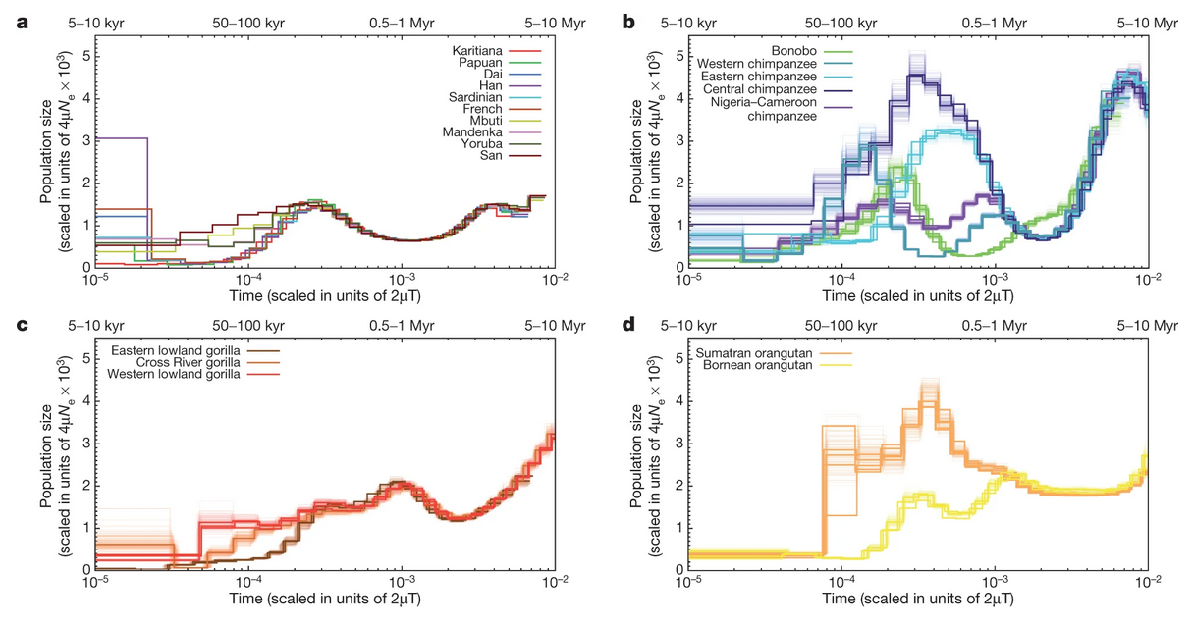
Example of PSMC output
Nature volume 499, pages 471–475 (2013)

Slide 37
Using Relate for Genome-Wide Coalescence
Relate infers genome-wide genealogies
Uses thousands of genomes
Outputs: Coalescence rates, Ne curves, tree sequences

Slide 38
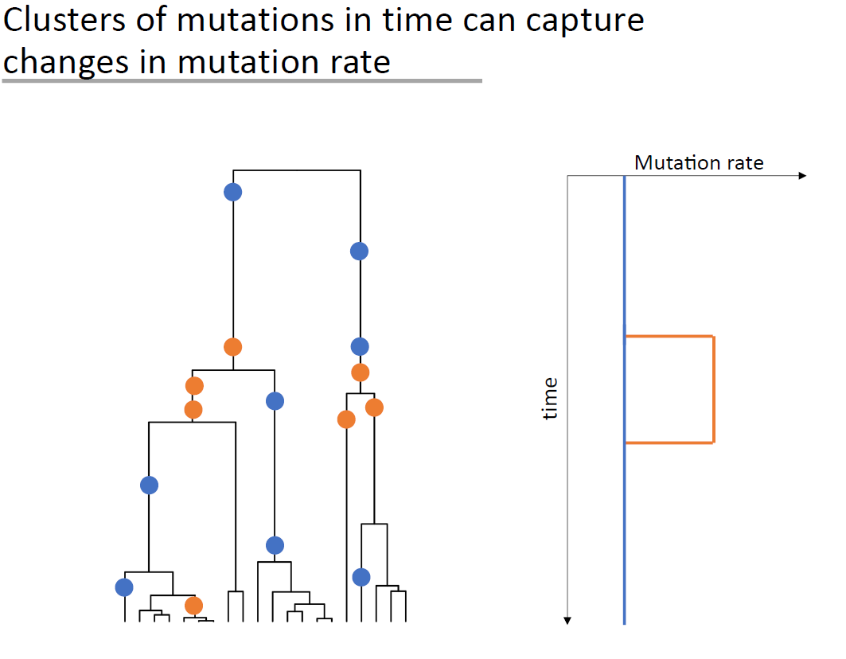
Relate & mutation rate
from Leo Speidel

Slide 39
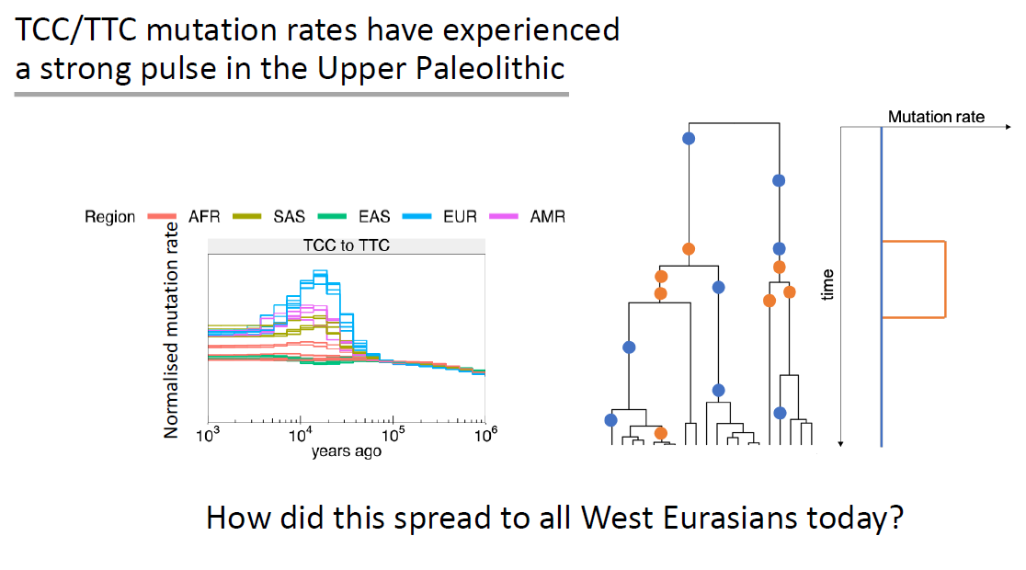
Relate & mutation rate
from Leo Speidel

Slide 40
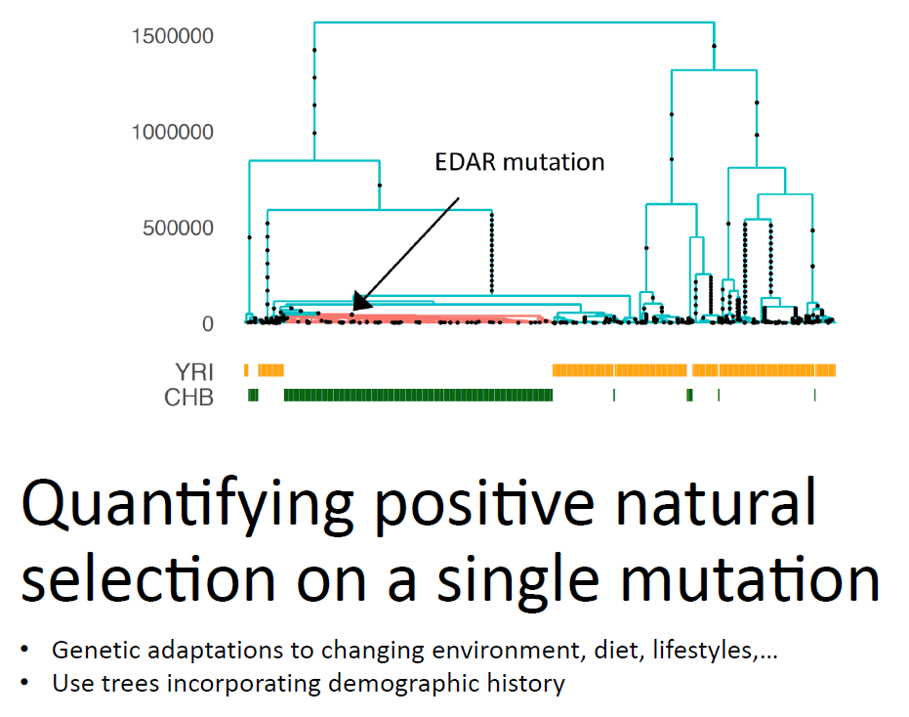
Relate & positive selection
from Leo Speidel

Slide 41
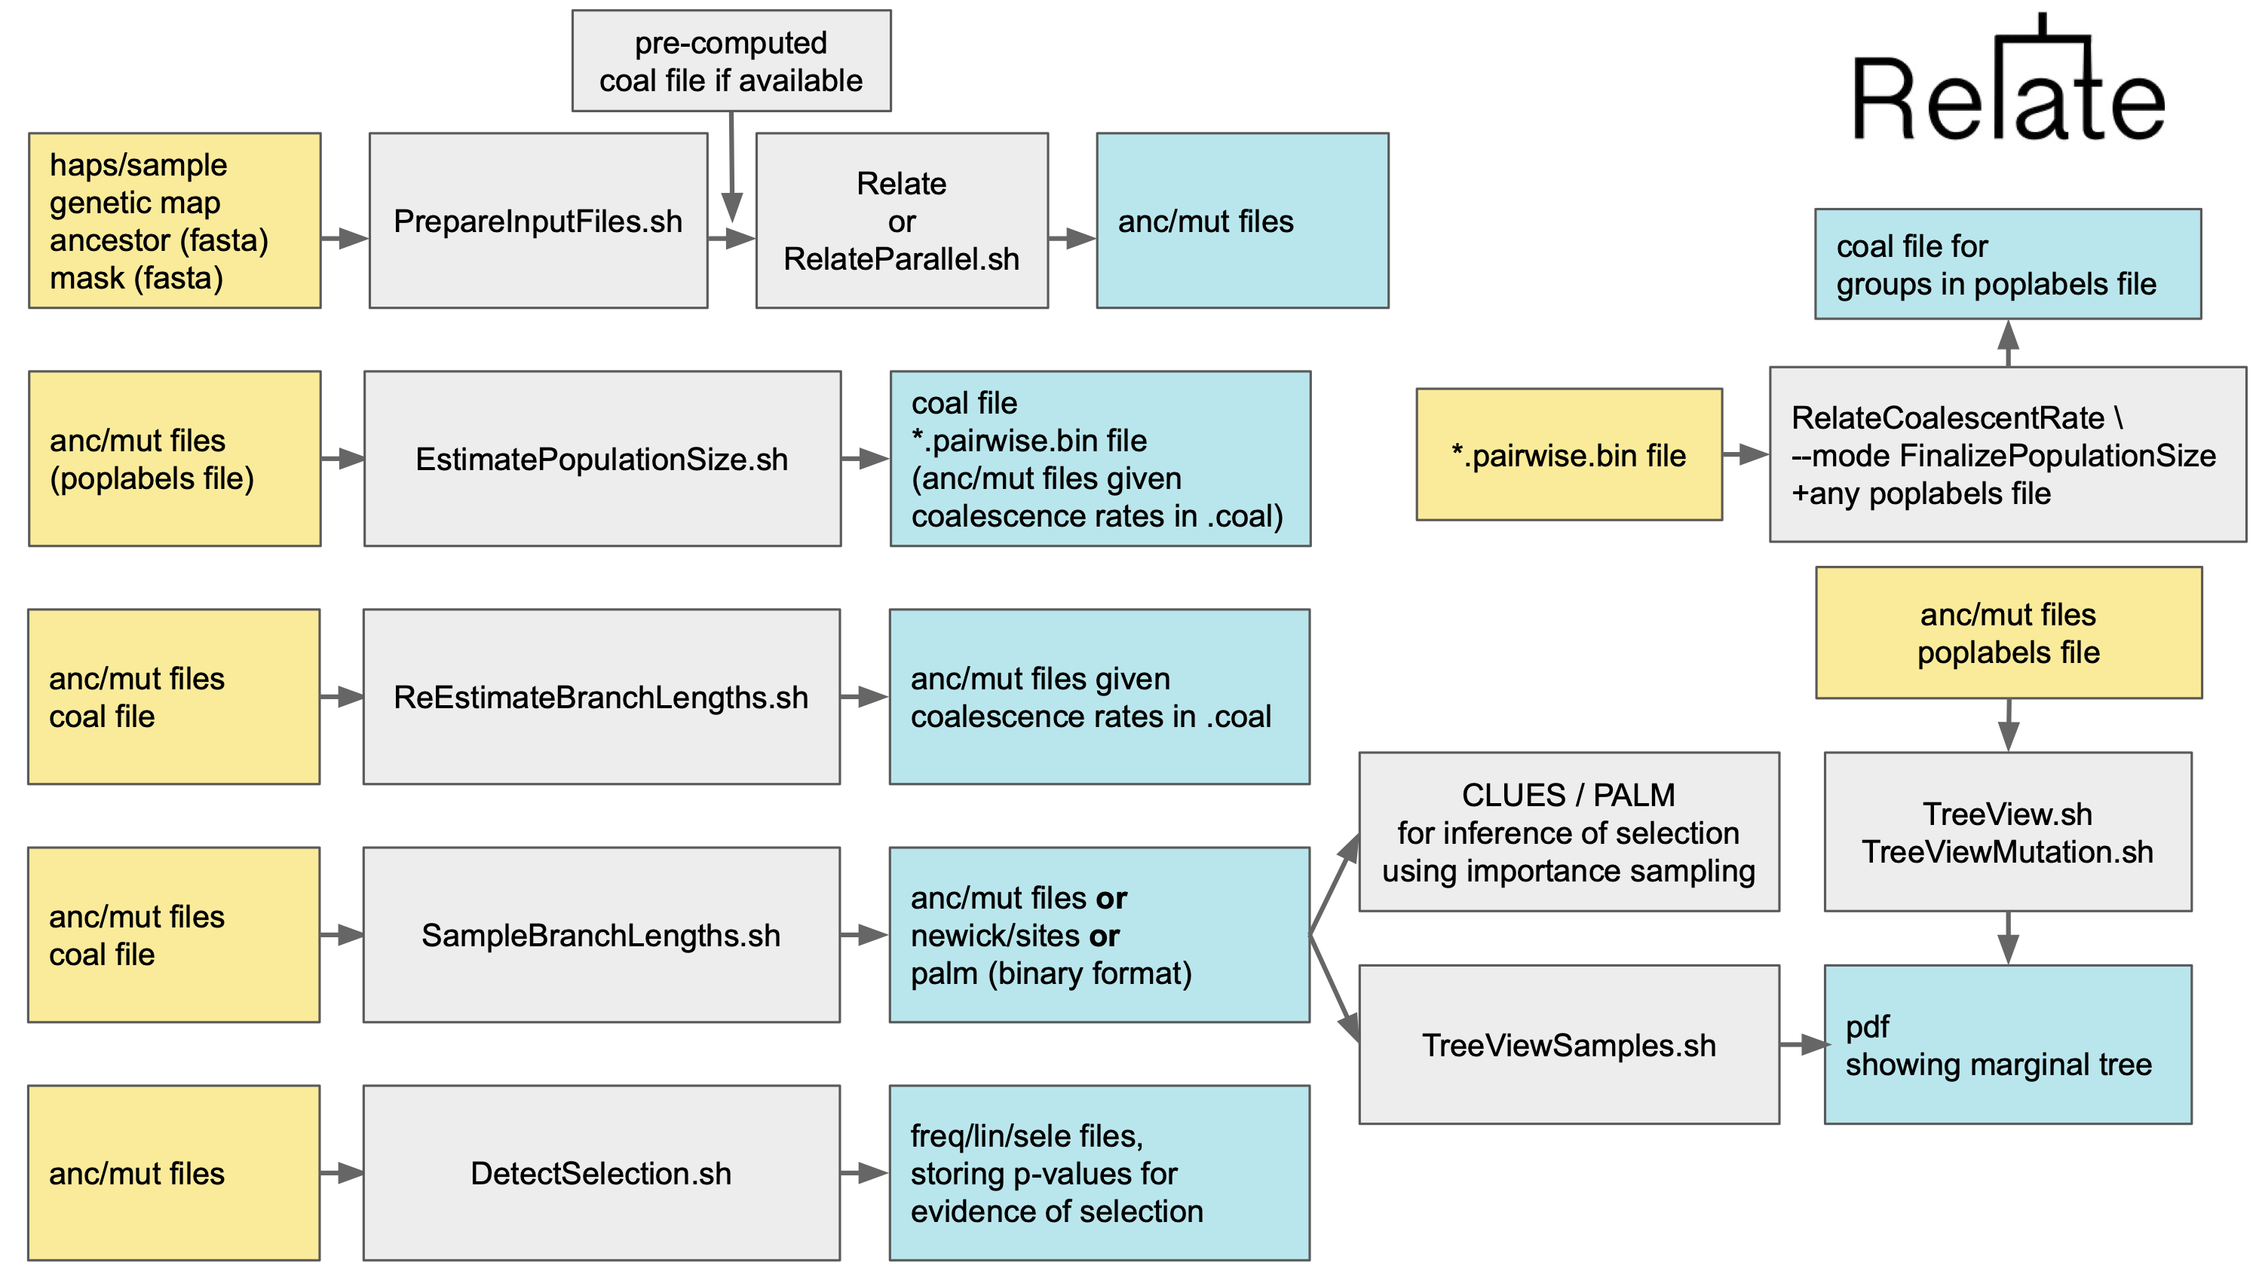
RELATE

Slide 42

Limits of SMC-based models
Presence of transposons or repetitive elements
Extreme demographies
High recombination and mutation rates
Adapted from Alba Nieto

Slide 43
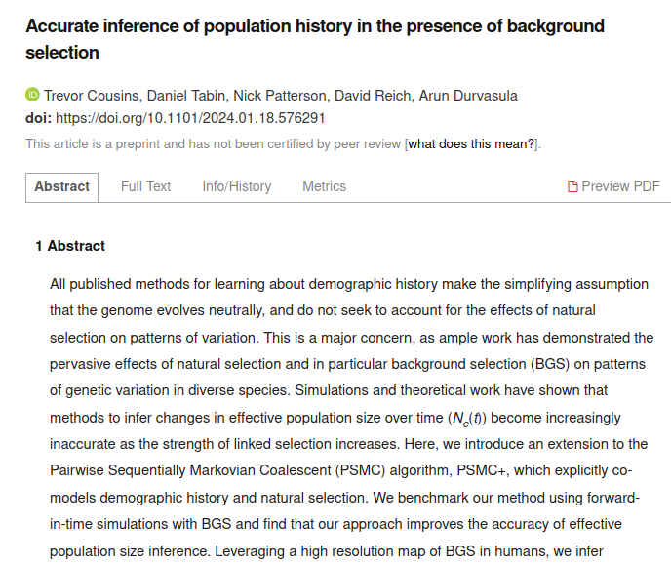
Limits of SMC-based models
Background selection
Adapted from Alba Nieto

Slide 44
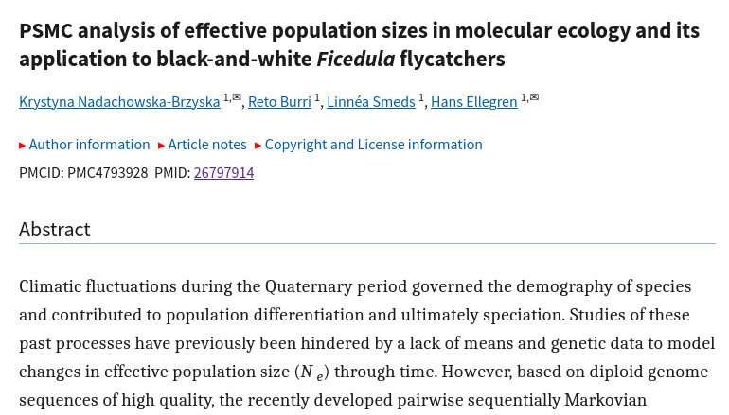
Limits of SMC-based models
Variant calling restrictions (quality)
Adapted from Alba Nieto

Slide 45
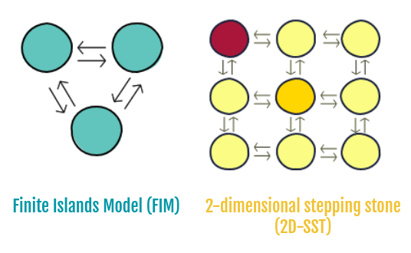
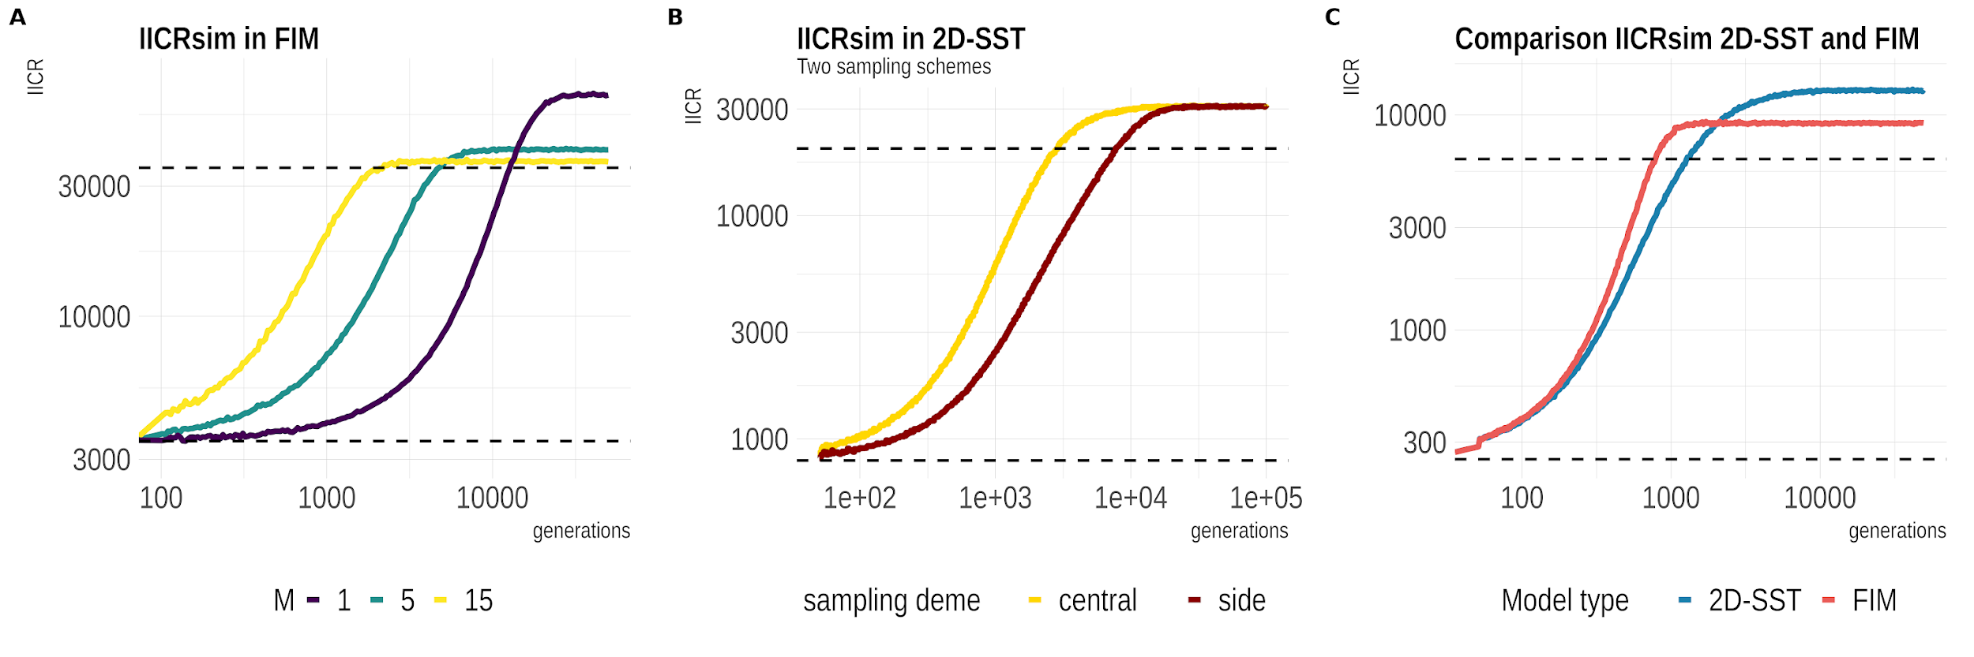
WARNING: ASSUMPTIONS!!!!!
Expected IICR under population structure
Demographic parameters
Sampling sites
Type of underlying model
Adapted from Alba Nieto

Slide 46
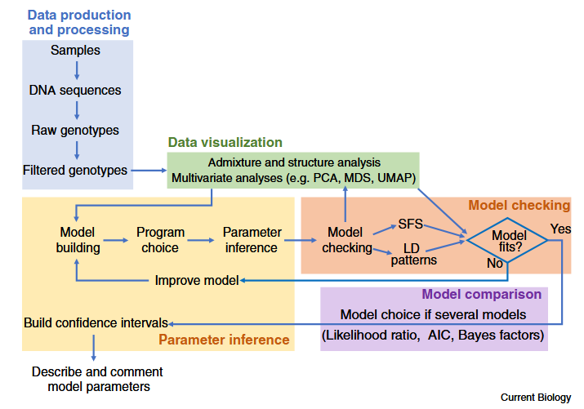
Demographic modelling

Slide 47
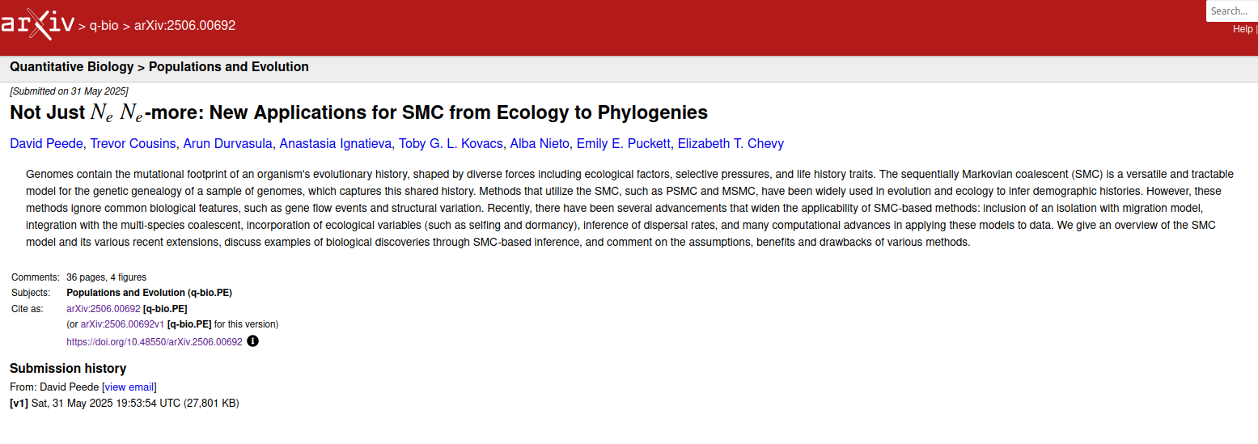
More on SMC-based models

